Slide 1
Advances and challenges in health services offered to LGBT families: what is needed to move forward
David J. Martens, MD
Adolescent Medicine Specialist
Montreal Children’s Hospital

Slide 2
Spot diagnosis

Slide 3
Objectives
Definitions
Timeline of LGBT rights in Canada
LGBT parents and their children
Experiences of LGBT parents and their children with health care professionals
Strategies to improve communication between LGBT families and health care professionals

Slide 4
Definitions
Lesbian – a homosexual woman
Gay – homosexual, especially a man
Bisexual – a person who is attracted to both men and women
Transgender - of, relating to, or being a person who identifies with or expresses a gender identity that differs from the one which corresponds to the person's sex at birth.

Slide 5
Milestones in lesbian/gay/bisexual/trans rights in Canada
1968: Homosexual behavior decriminalized
1977: Quebec first province to include sexual orientation in its Human Rights Act.
1989: The Canadian Human Rights Commission ruled that same-sex couples, and their children should be considered a family

Slide 6
Milestones in lesbian/gay/bisexual rights in Canada
1996: The term "sexual orientation” added to the Federal Human Rights Act.
2004-MAR: The Quebec Court of Appeal rules that homosexuals have the right to marry
2005-JUL-20: same-sex marriage legalized
2017-June: Bill to protect rights of trans individuals in Criminal Code and Canadian Charter of Human Rights passed by Senate.

Slide 7
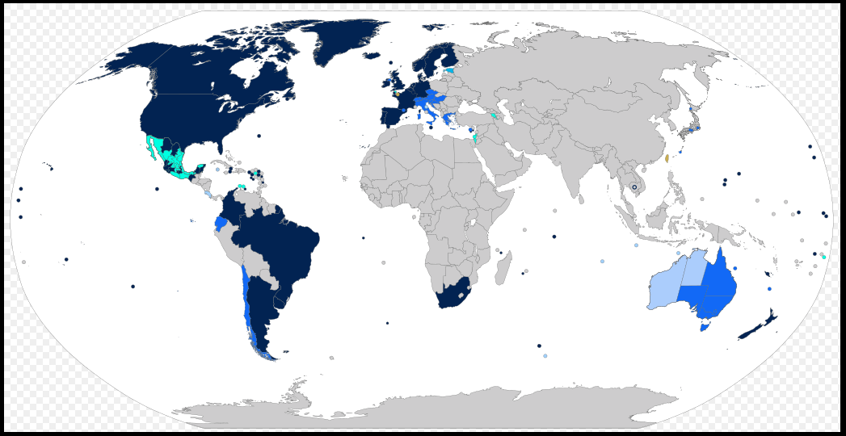

Slide 8
Homosexuality & Medicine
1973: the American Psychiatric Association votes to remove homosexuality from the DSM-II
1992: World Health Organization removes homosexuality from ICD-10
Notes:
International Statistical Classification of Diseases

Slide 9
Modern Families

Slide 10
Modern Families
Children from previous heterosexual relationships
Adoption
Artificial insemination
Surrogacy
Surrogate may have varying degrees of involvement with child and family

Slide 11
Parenting
Comparison of lesbian and heterosexual mothers
No differences in maternal warmth
emotional involvement
enjoyment of motherhood
frequency of conflicts
supervision of the child
Golombok et al., 2003 Dev Psychol 39:20-33
Notes:
UK study, 14 000 moms

Slide 12
The kids are alright
Adolescents raised by 2 moms no different than peers raised by heterosexual parents in measures of:
Self-esteem
Depression
Anxiety
School connectedness
School success
Wainwright et al., 2004 Child Dev 75:1886-1898
Notes:
12 105 US adolescents in grades 7-12 from ADD Health study, randomly selected, nationally representative sample
12-18 year olds living with 2 women (n=44) similar to peers raised by heterosexual parents (n=44) in

Slide 13
The kids are alright
No increase in gender dysphoria
More likely to consider relationship with person of same gender
No difference in number of kids identified as homosexual

Slide 14
The kids are alright
Adult children of lesbian parents report more teasing
More tolerant of diversity and more nurturing

Slide 15
LGBT parents’ experiences with health care system
Experience largely positive
Problems
Disclosure of sexuality
Heterosexist assumptions
Discrimination
Lack of knowledge
Shields et al., 2012 Worldviews on evidence-based nursing: 200-209
Notes:
Systematic review on LGBT parents’ experiences with health care system
4 papers, 3 Australian, 1 US/Canada
Mikhailovich - Satisfaction 89% for general practitioners, 62% for pediatricians, 61% for ER department, 60% for all nursing and medical staff during stay in hospital
16% dissatisfied with ER, 11% with pediatricians, 11% with nursing and other medical staff
Perrin and Kulkin – 45% preferred gay and lesbian health providers, 31% preferred special clinic for gay and lesbian parents. 39% had problems with primary pediatric care, 53% with clinics and 39% with hospitals. 40% suffered non-exclusion of non-biological parent, reported deficiencies in health care system related to sexual orientation
McNair – heterosexism, disclosure
Rawsthorne – positive experiences, many parents surprised

Slide 16
Approach to LGBT families
Who are primary caregivers and how are they related?
What kind of supports in place or needed?
Involve whole family – don’t leave anyone out
Legal requirements about who can give consent
What does child know about their parents? How do they feel about their parents relationship?
Educate ourselves and co-workers about LGBT families
Notes:
Forms
Develop admission /assessment forms that are inclusive and not heterosexist
Correct pronouns for trans individuals
No tolerance of anti-gay language
Current and up to date education for staff about special needs and issues of LGT famlies, sensitivity and awareness training

Slide 17
Patient assessment/intake forms
Develop admission /assessment forms that are inclusive and not heterosexist
Correct pronouns and gender designation for transgender individuals
No tolerance of anti-gay language

Slide 18
Examples of forms

Slide 19
Conclusion
Number of same sex couples increasing across Canada
LGBT parents and their children no different from families from heterosexual relationships
Learning to communicate effectively with LGBT parents and their children is key to providing effective family centered care
One easy place to start is to look at patient forms

Slide 20
Resources for LGBT parents and their families
www.familleshomoparentales.org
www.educaloi.qc.ca
www.egale.ca
www.lgbtqparentingconnection.ca/home.cfm

