Slide 1
Access to Healthcare for Persons with Gender Variance: barriers and improvements
Shuvo Ghosh, MD, FAAP
Developmental-Behavioural Pediatrican
Assistant Professor, Dept. of Pediatrics, McGill University
Co-Director, Meraki Health Centre

Slide 2

WORLD OF THE GENDER BINARY

Slide 3
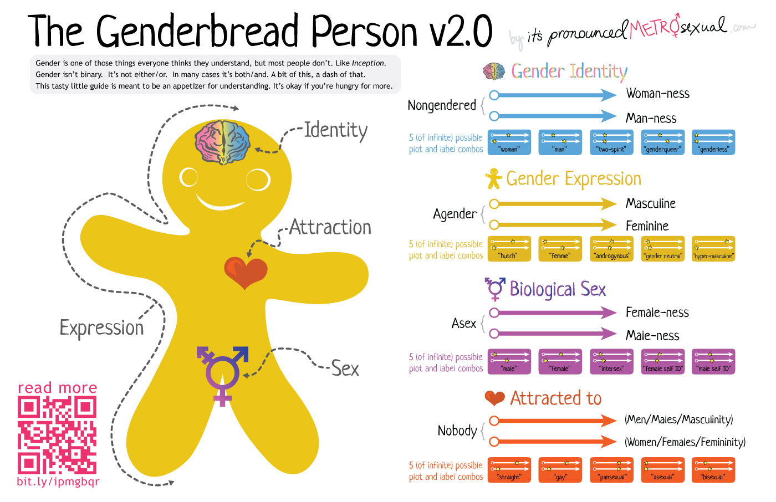

Slide 4
WORLD OF THE GENDER CONTINUUM
Multiple realities of gender identity
Multiple ways to express gender
Multiple acceptable behaviours
Multiple definitions recognised
Maleness and femaleness defined as part of a larger group
Biology, society, epigenetic phenomena all together

Slide 5
CURRENT THINKING
Under current concept of gender variance/non-conformity/independence, approx 1-3% of population presents in early years with atypical behaviours

Slide 6
MARGINALISATION
There are many identifiable marginalised groups in our society (many who pass through the hands/doors of youth protection)
There are others who are “invisible”
The trans population is perhaps the most visible and the most invisible
  Many trans people are “stealth”
  Other trans people are “easily” identifiable
  Yet others appear to be doing well or poorly but their interior life is unknown to the rest of society

Slide 7
THE PROFESSIONAL ROLE
The need to move beyond pathological definitions to variation from the norm (or the average, typical, mean)
Honest exploration of each patients needs, wishes and hopes
Using our expertise to best serve people rather than to control or shape people in a certain way
Understanding the needs of family members, the parents and the best way to reconcile all of these issues with the child’s experience

Slide 8
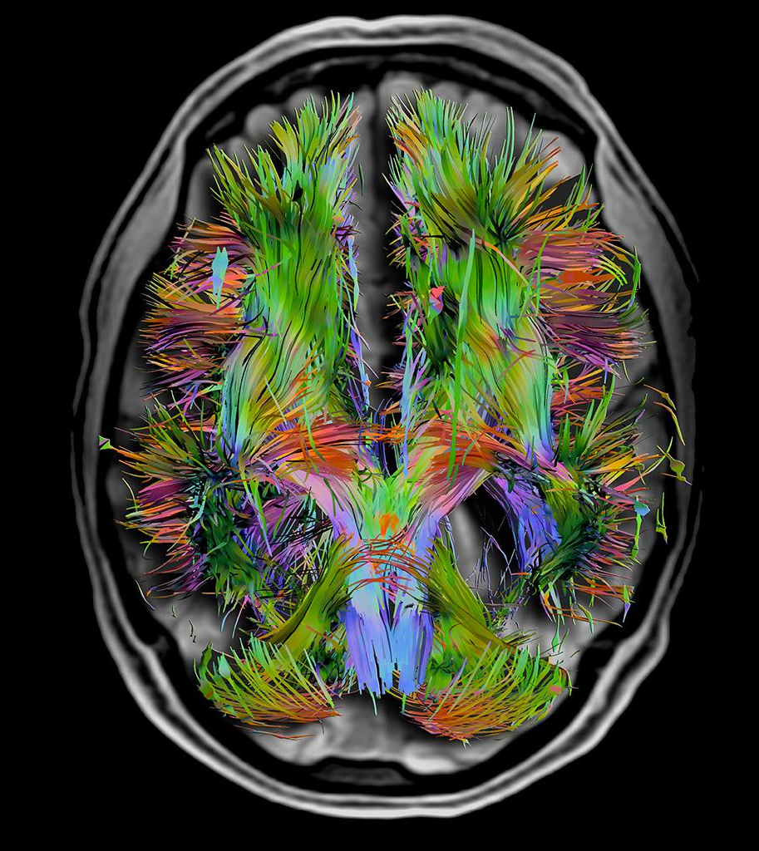
GENETICS OF THE BRAIN
Over 3000 gene loci have been identified that respond to testosterone exposure
These may be involved in responses both pre and post-natally

Slide 9
BEHAVIOURS
Incongruent behaviours are not always pathologised:
  Girls who prefer rough-tumble play (“tomboys”) are often encouraged to continue
  Some parents allow their young sons to pursue “girlish” interests: sewing, playing with dolls, but most are considered “sissy boys”
  Variation of “boy” in both cases…

Slide 10
INTERVENTION
Decisions about care have been made at the following times:
  In infancy for kids with ambiguous genitalia or any intersex condition
  In school-age when intense and persistent feelings are expressed on a regular basis
  At the onset of puberty
  At the time of reaching majority (16+ for non-invasive care, 18 for care with legal ramifications)

Slide 11
STRATEGIES
The pathway:
  “Watch and wait”
  Slightly more intervention with guidance about the possibility of transition or gender ambiguity at a later age
  Concrete treatment steps such as discussion of therapies (medications/hormones, surgeries, etc.)

Slide 12
SUPPORT
Parents are naturally very anxious about leaving children in “the middle” but it is a responsibility of professionals to help remove the stigma associated with either intersex state or gender variant behaviours
Frank discussions must be undertaken as early as possible

Slide 13
CHALLENGES IN CARE
Supporting a child with gender variance while respecting privacy
Providing adequate information to peers without alienating the child or causing stigma
Feeling equipped to discuss the situation with parents or family members of classmates
Knowing what accommodations/interventions are most helpful for trans kids

Slide 14
CHALLENGES FOR COMMUNITY HEALTH PROFESSIONALS
A lack of experience
A lack of comfort
A lack of information
A lack of context
Numerous co-existing factors that complicate a psychosocial situation
Multiple medical or health issues
Difficulties with mental health

Slide 15
What NOT to do
PLEASE do not say, nor accept amongst your colleagues or other practitioners from any walk of life the comment “I don’t have the expertise to…”
  This is UNACCEPTABLE and would not be said of any other marginalised group
PLEASE do not presume to know a person’s identity better than they know their own identity
  Nothing could be more condescending
  This applies even to those with mental health issues (apart from an individual in florid psychosis)

Slide 16
KINDS OF THERAPY
Psychosocial
Medical
Surgical (steps as a teen, others >18)
Non-surgical options
Approaches and discussions

Slide 17
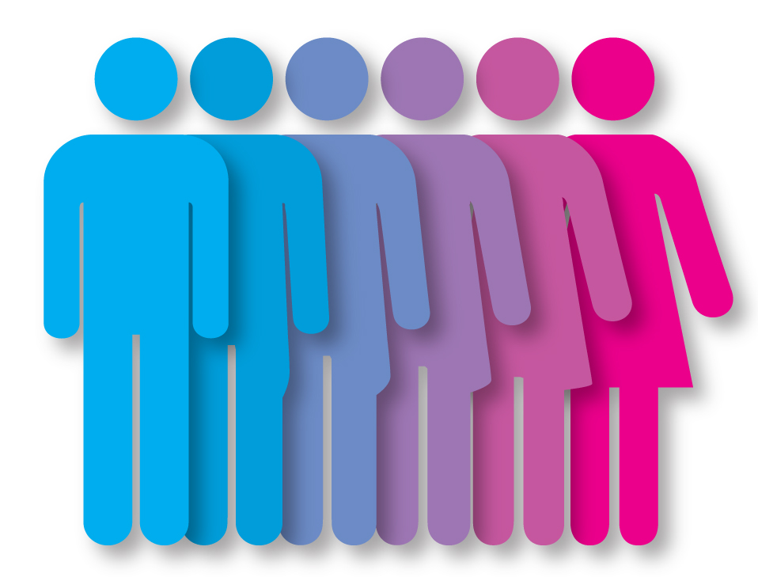
Canadian Resources
Gender Creative Kids network & website
Centre for Gender Advocacy (Concordia)
McGill University Sexual Identity Clinic
Trans association of Québec
Project 10
Intersex society of North America
Transhealth Montreal
TransPULSE in Toronto
Rainbow Health Ontario
Head & Hands Clinic NDG
Gender Variance Program @
Meraki Health Centre

